Slide 1



Douban Database

Slide 2





Introduction
People are paying more and more attention to culture life.
Understand people's preferences for cultural types by studying movies and books data .
Help people enrich their cultural life
Companies can also get some suggestions

Slide 3

+
Schema & ER Diagram
01
Normalization: From 1NF to BCNF
Process of drawing ER diagrams

Slide 4
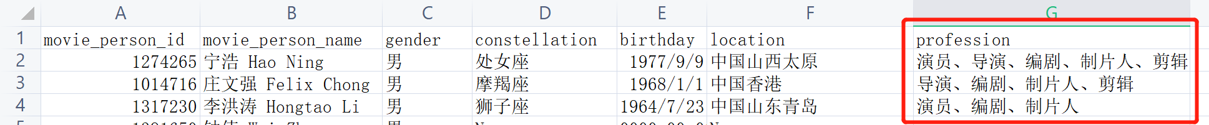
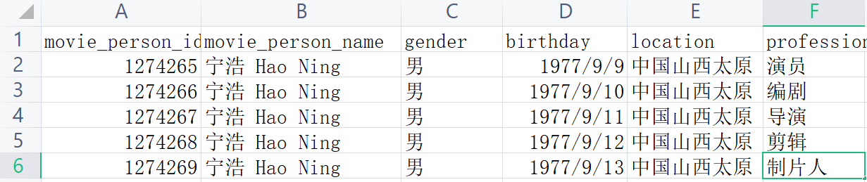
Normalization: 1NF
1NF
A relation schema R is in first normal form (1NF) if the domains of all attributes of R are atomic.
using “movie_person” as an example
movie_person(movie_person_id, movie_peroson_name, gerder, constellation, birthday, location, profession)
not atomic
√ 1NF

Slide 5
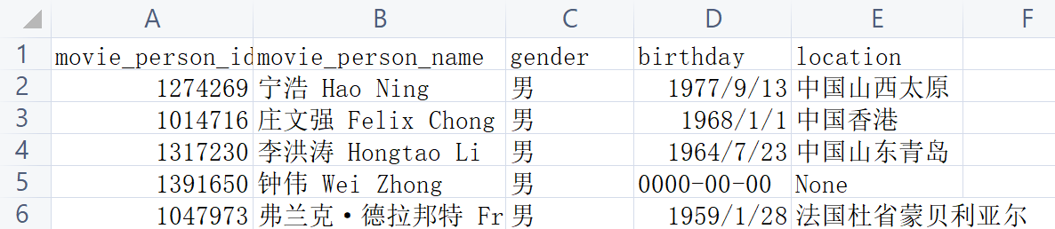
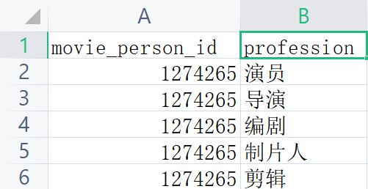
Normalization: 2NF
2NF
A relation schema R is in second normal form (2NF) if every nonprime attribute A in R is fully functionally dependent on the primary key
(assuming it is the only candidate key)
using “movie_person” as an example
movie_person(movie_person_id, movie_peroson_name, gerder, constellation, birthday, location, profession)
problem1. redundency
2.not functionally dependent
movie_person(movie_person_id,
movie_peroson_name, gerder, constellation, birthday, location)
movie_profession(movie_person_id, profession)

Slide 6
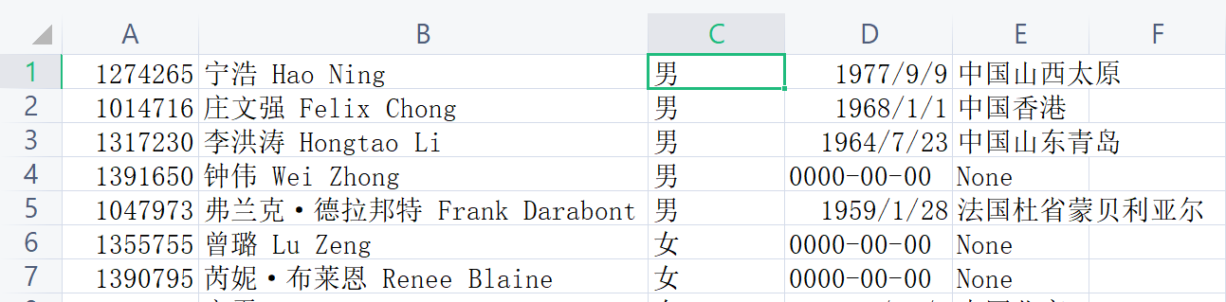

Normalization: 3NF & BCNF
using “movie_person” as an example
movie_person(movie_person_id,
movie_peroson_name, gerder, constellation, birthday, location)
movie_profession(movie_person_id, profession)
3NF: Satisfies 2NF and has no transitive dependency
BCNF: Satisfies BCNF
Every determinant is a superkey.

Slide 7
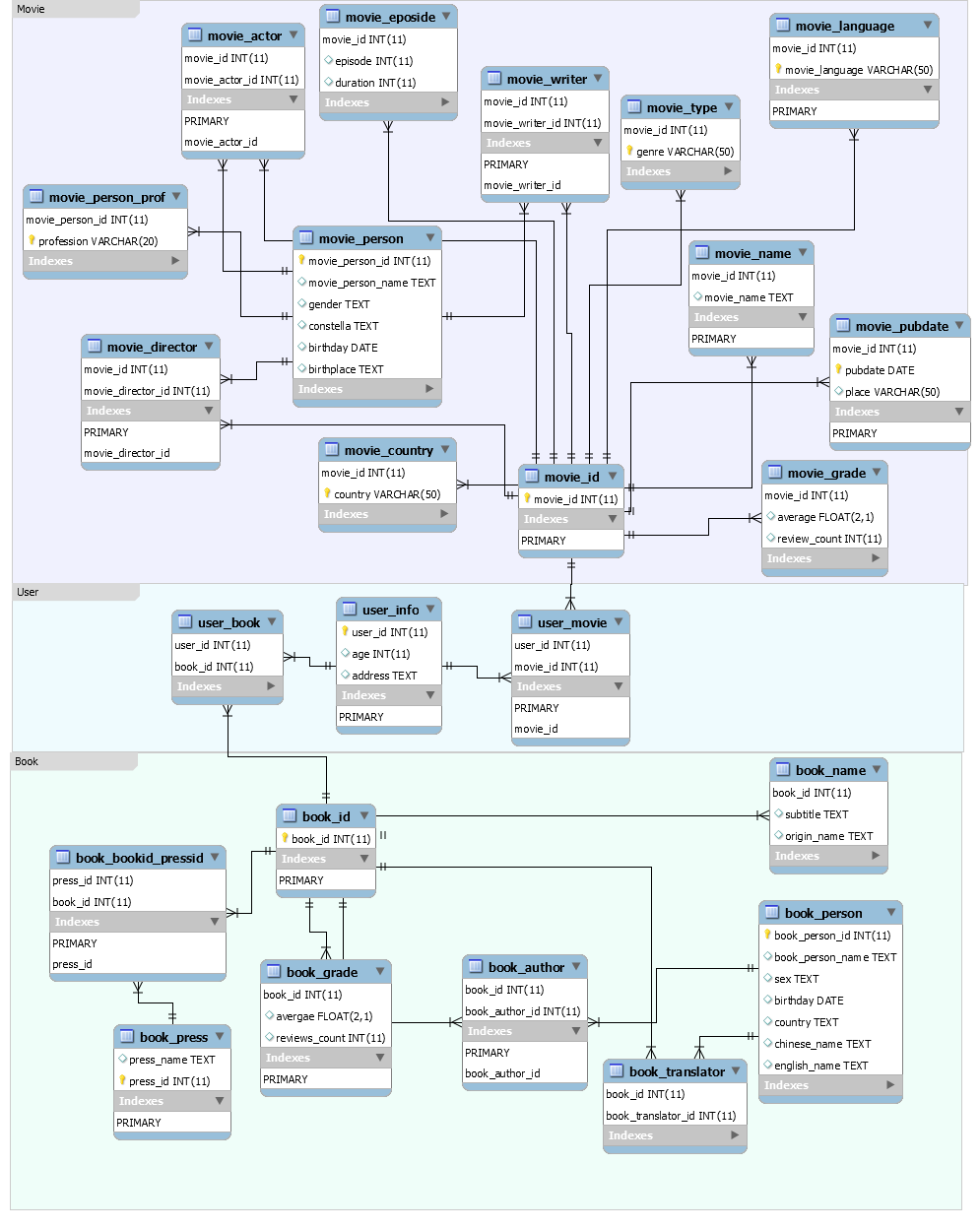
ERD design
Structure: Movie, Book and User
Data Type
Mainly uses integer, float and text
Advantages
has as less redundancy as possible
satisfies BCNF but is dependency preserving
has a clear structure

Slide 8
+
02
Implementation

Slide 9


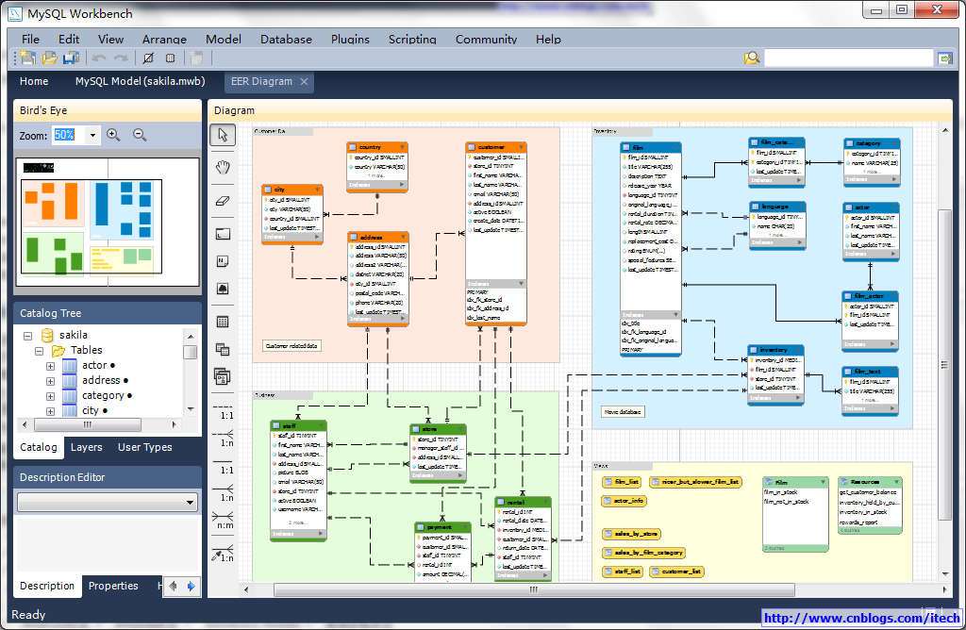


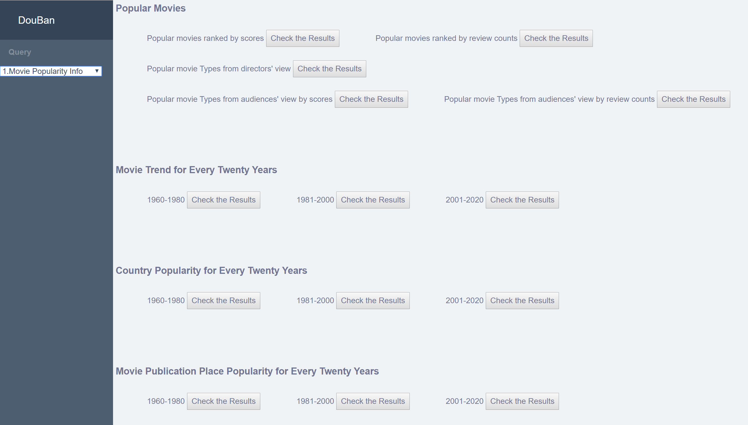


Implementation
GUI
Procedure:
Mysql: create tables, implement queries
backend
2 million pieces of data
Connection:
url
response
website is visited
mysql query
render
data

Slide 10
+
03
Result

Slide 11
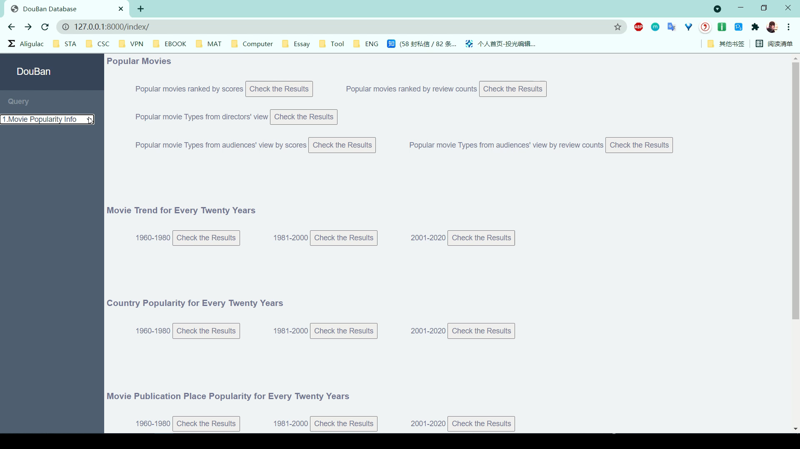
Result

Slide 12
+
04
Data Analysis

Slide 13
Basic Functions
Commercially
Valuable Practitioners
Rank
Rank
Movie
Book
District of Readers
Audience Age
Country, Duration
Commercially
Valuable
Writers, Publishers, Translators

Slide 14
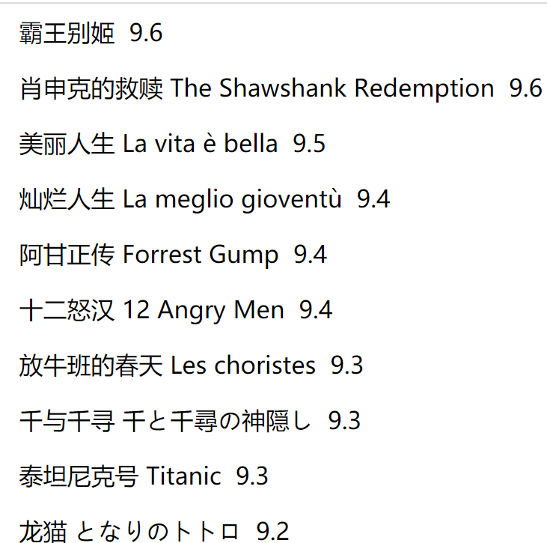
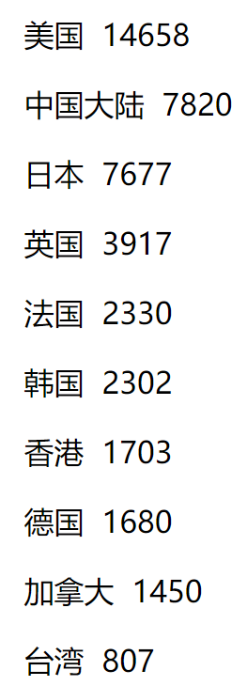
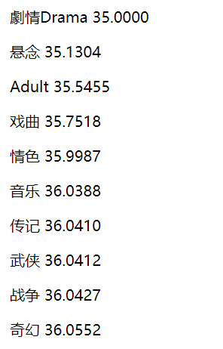
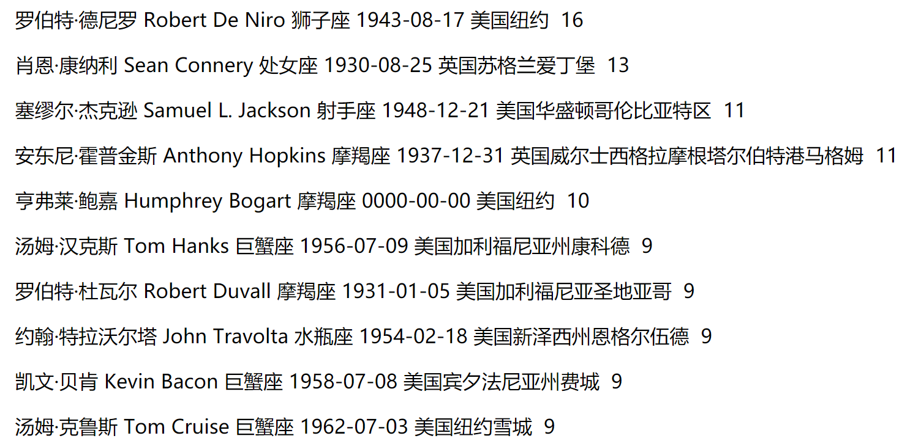
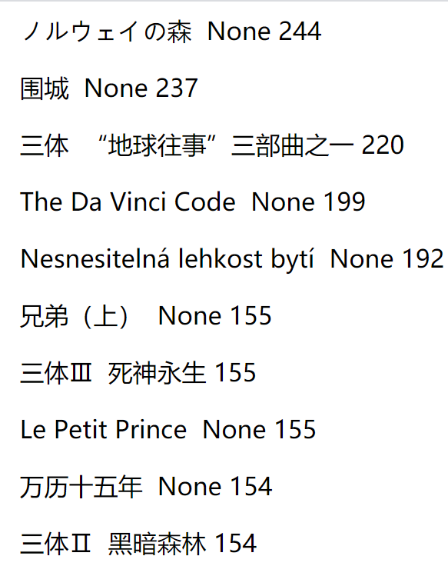
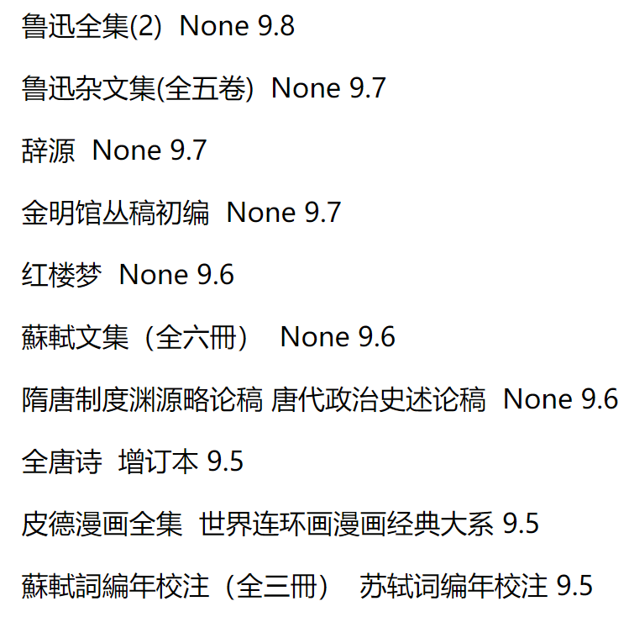
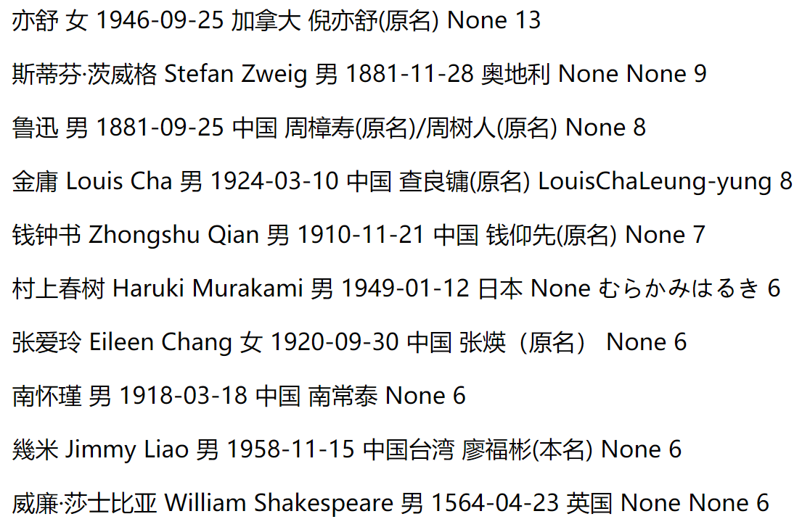
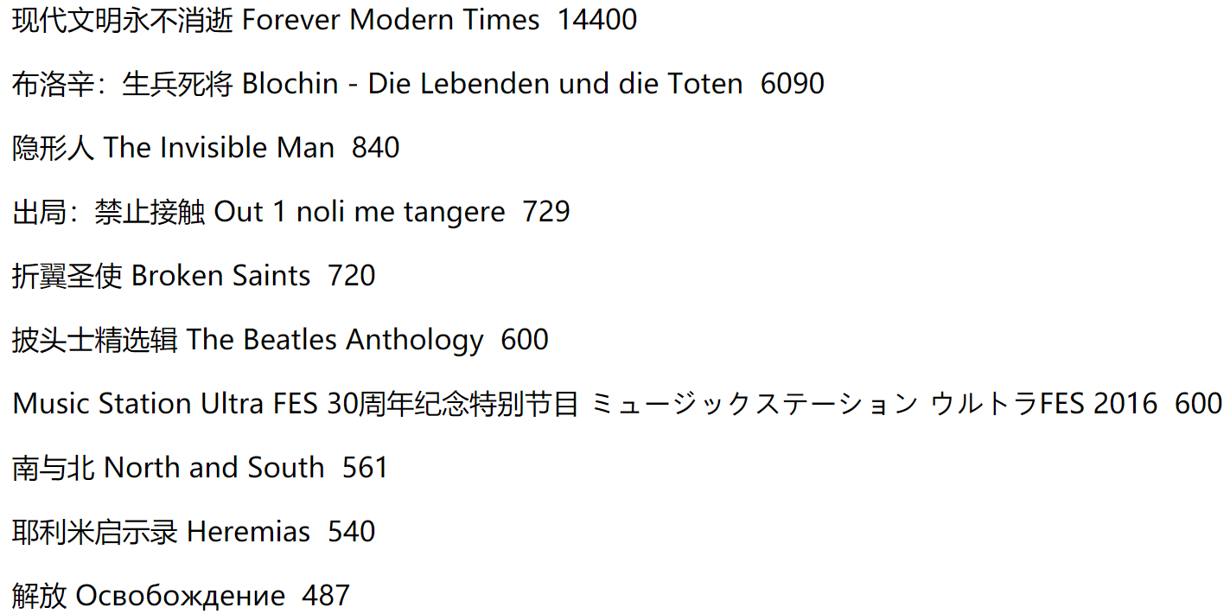
Basic Functions
movie rank
movie country
movie type
excellent actor
duration
book rank
excellent writer
book rank in Shanghai

Slide 15
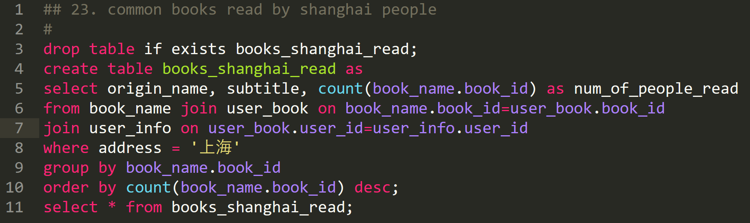
Mysql Query

Slide 16
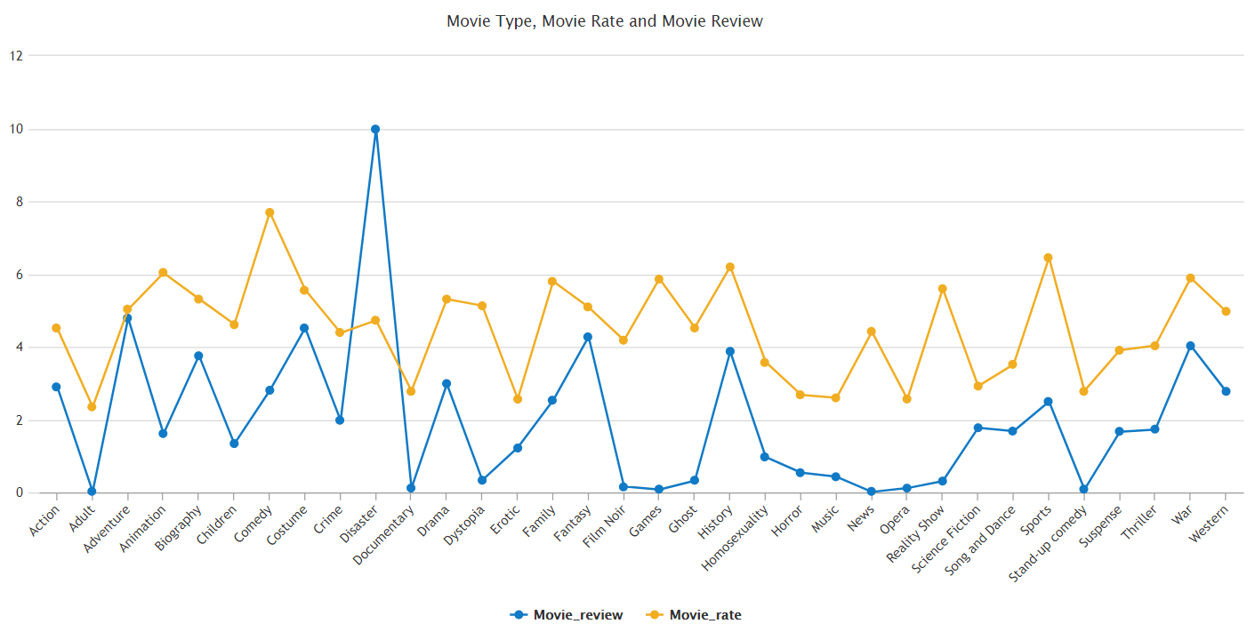
Outcome 1
Popularity vs Quality of Movies with Distinct Types
Disaster
Animation
Movie Scores
Movie Reviews

Slide 17
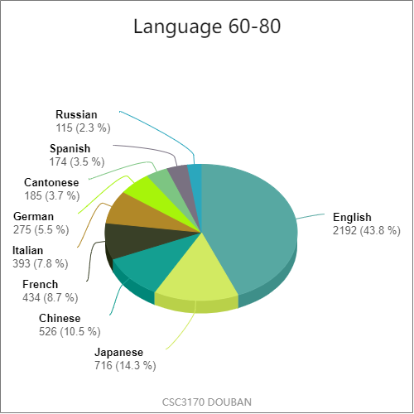
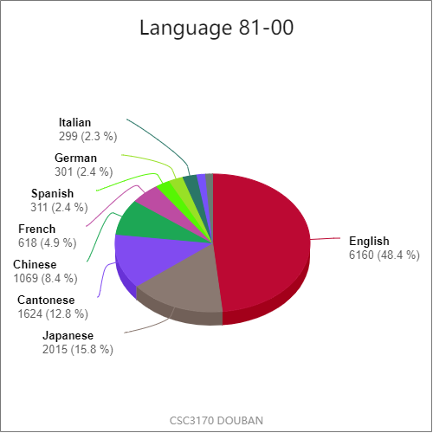
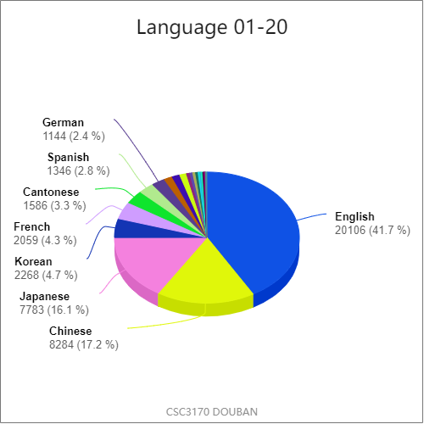
Outcome 2
Movie Trend --- Country

Slide 18
Outcome 3
Distriction and the Most Popular Books
Besiege a City (316)
Norwegian Wood (308)
Remembrance of Earth's Past
(290)
4. The Da Vinci Code (274)
5. To Live (268)
Beijing
Besiege a City (60)
Norwegian Wood (57)
The Unbearable Lightness of Being (45)
The Da Vinci Code (45)
Le Petit Prince (38)
Shanghai
Norwegian Wood (244)
Besiege a City (237)
Remembrance of Earth's Past (220)
The Da Vinci Code (199)
The Unbearable Lightness of Being (192)
Guangzhou

Slide 19

Data Mining
Personalized Movie and Book Recommendation
Based on history
Association Analysis (The Apriori Principle)
R, mysql and Python

Slide 20
Data Mining
frequent item set mining
The Apriori Principle
association rule learning
R Library
database
arules，arulesViz
Apriori
R Library arules
support and confidence limitation
association rules
remove repetition
python
plot
recommendation
rules.csv
distribution diagram

Slide 21
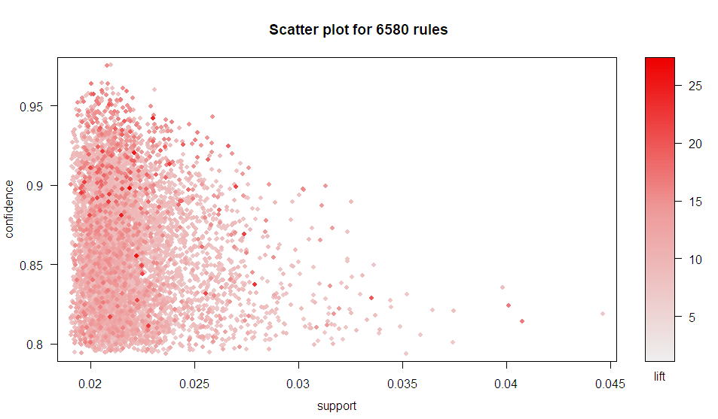


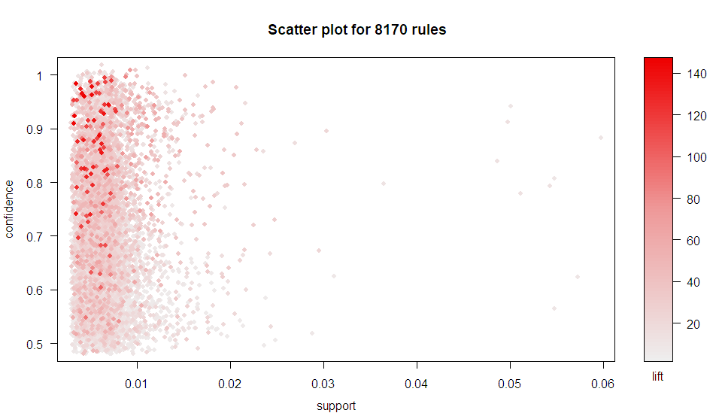
Data Mining
Movie and Book Association
Example

Slide 22
+
05
Conclusion

Slide 23
Conclusion
Douban Database
commercial value analysis
research on cultural industry
Abundant data for
Schemas satisfying BCNF form
A user-friendly interface
Data analysis outcomes:
Popularity vs quality of movies with distinct types
Movie yield of different countries in the past 60 years
District and reader tastes
Personalized recommendation

Slide 24
References
https://github.com/weizhixiaoyi/DouBan-Spider
https://www.douban.com
Notes:
Federal highway administration

